Slide 1
FE Practice (Section 1)

Slide 2
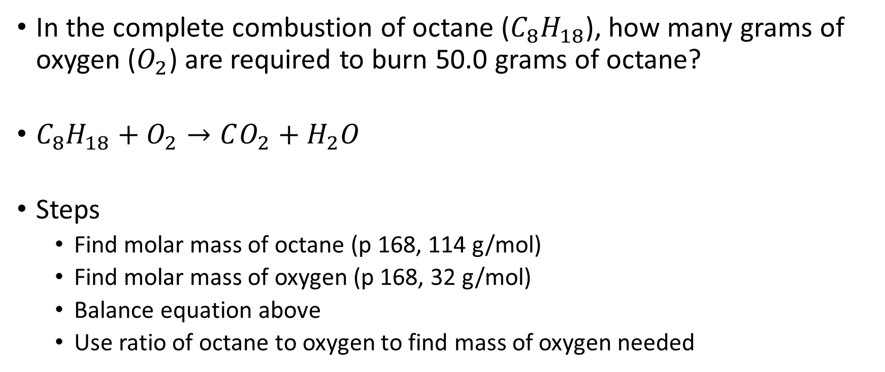
Stoichiometry Question
In the complete combustion of octane ($C_{8}H_{18}$), how many grams of oxygen ($O_{2}$) are required to burn 50.0 grams of octane?
$C_{8}H_{18}+O_{2}→CO_{2}+H_{2}O$
Steps
  Find molar mass of octane (p 168, 114 g/mol)
  Find molar mass of oxygen (p 168, 32 g/mol)
  Balance equation above
  Use ratio of octane to oxygen to find mass of oxygen needed

Slide 3
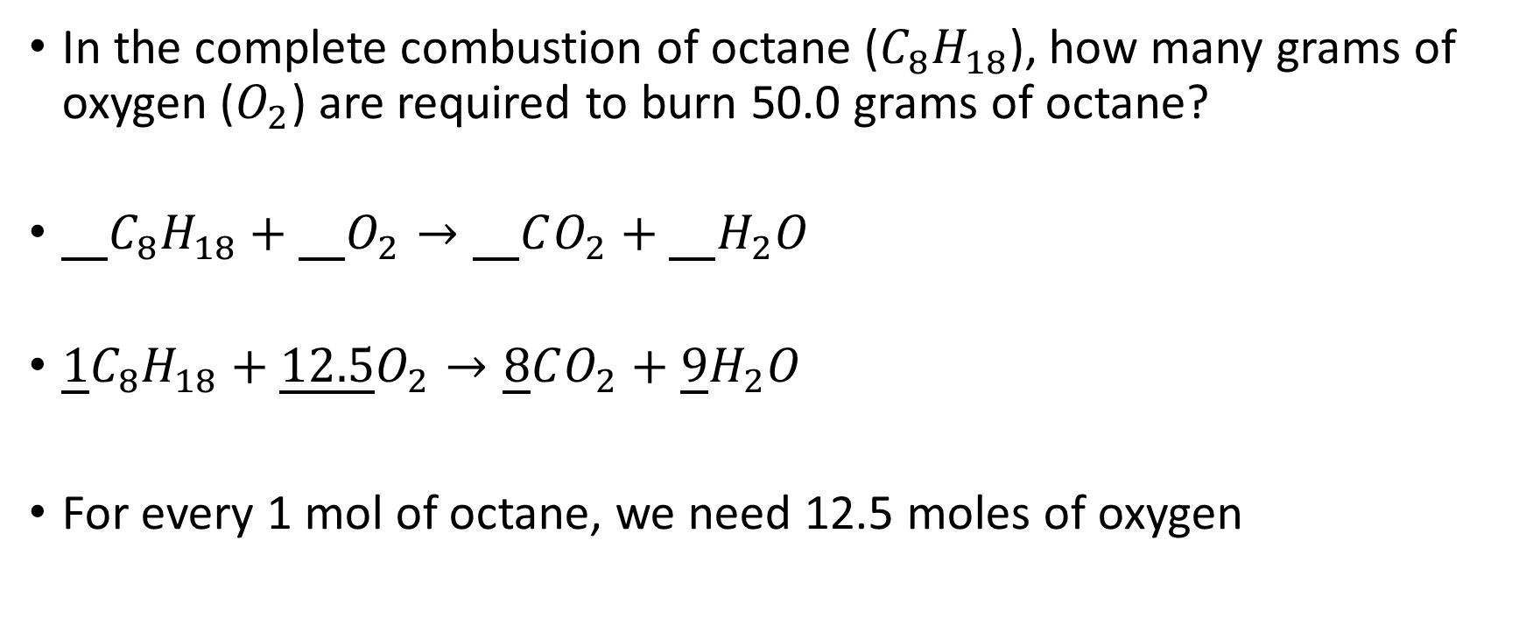
Stoichiometry Question
In the complete combustion of octane ($C_{8}H_{18}$), how many grams of oxygen ($O_{2}$) are required to burn 50.0 grams of octane?
$\underline{}C_{8}H_{18}+\underline{}O_{2}→\underline{}CO_{2}+{\underline{}H}_{2}O$
$\underline{1}C_{8}H_{18}+\underline{12.5}O_{2}→\underline{8}CO_{2}+{\underline{9}H}_{2}O$
For every 1 mol of octane, we need 12.5 moles of oxygen

Slide 4
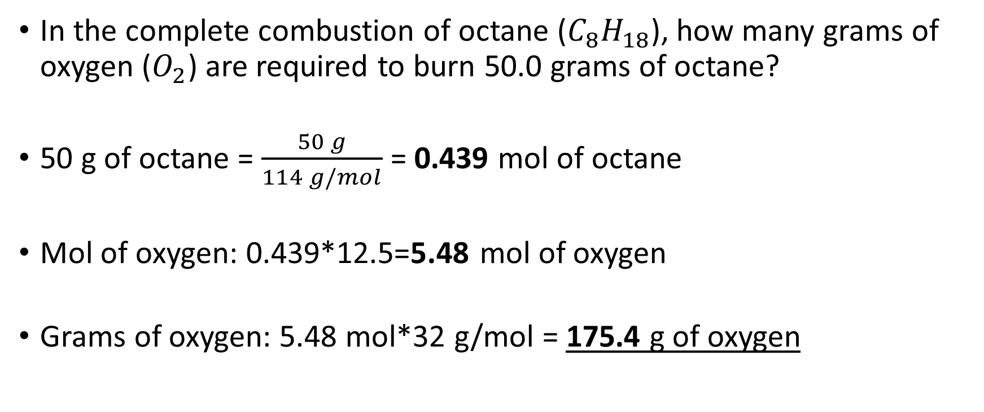
Stoichiometry Question
In the complete combustion of octane ($C_{8}H_{18}$), how many grams of oxygen ($O_{2}$) are required to burn 50.0 grams of octane?
50 g of octane = $\frac{50 g}{114 g/mol}$ = 0.439 mol of octane
Mol of oxygen: 0.439*12.5=5.48 mol of oxygen
Grams of oxygen: 5.48 mol*32 g/mol = 175.4 g of oxygen

Slide 5
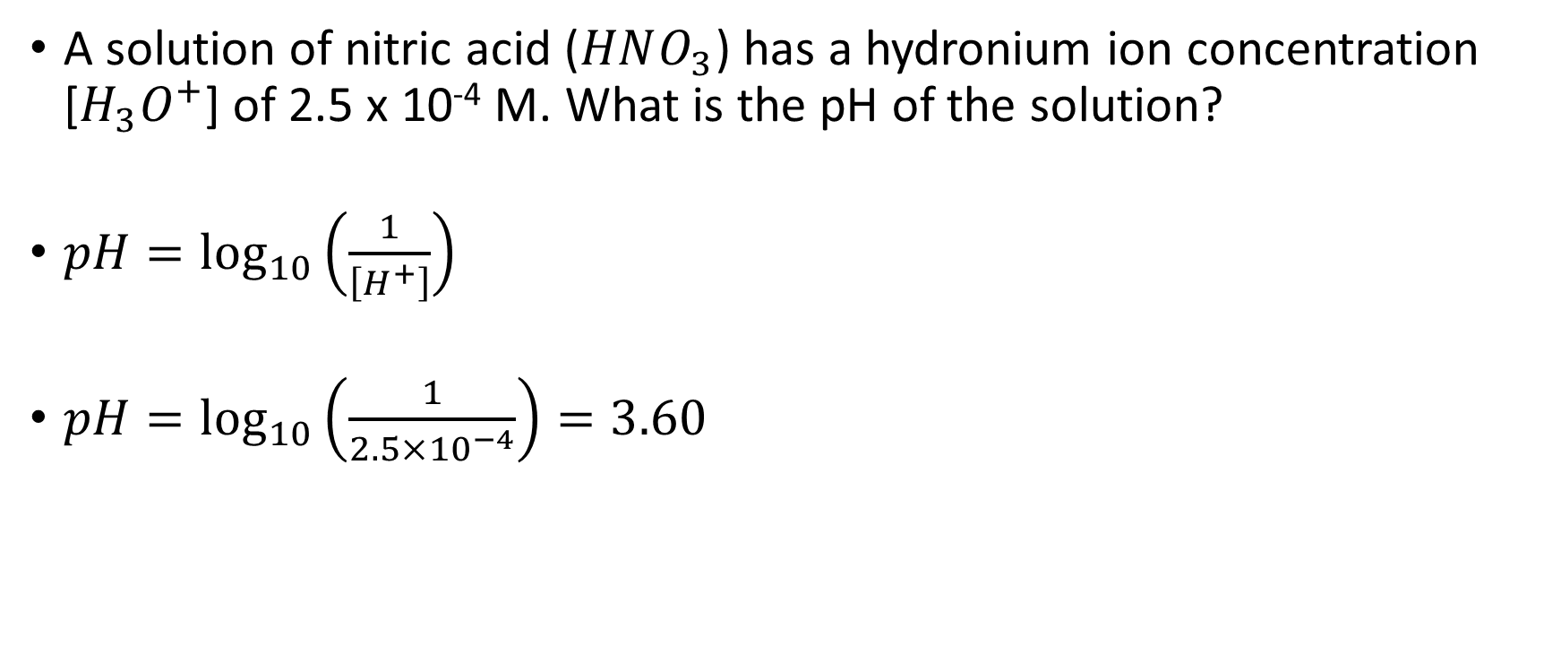
Acid-Base Question
A solution of nitric acid ($HNO_{3}$) has a hydronium ion concentration [$H_{3}O^{+}$] of 2.5 x 10⁻⁴ M. What is the pH of the solution?
$pH=\log_{10}\left(\frac{1}{\left[H^{+}\right]}\right)$
$pH=\log_{10}\left(\frac{1}{2.5×{10}^{−4}}\right)=3.60$

Slide 6
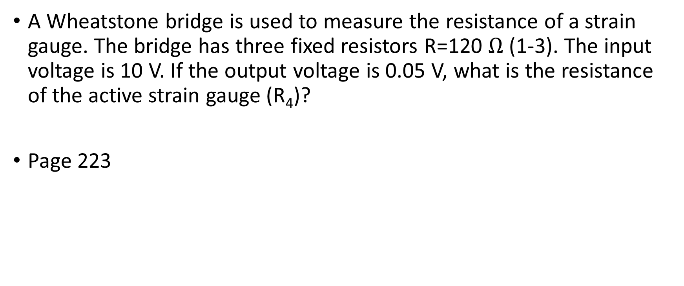
Instrumentation Question
A Wheatstone bridge is used to measure the resistance of a strain gauge. The bridge has three fixed resistors R=120 $Ω$ (1-3). The input voltage is 10 V. If the output voltage is 0.05 V, what is the resistance of the active strain gauge (R₄)?
Page 223

